Slide 1
Real Time Heart Disease Monitoring System

Slide 2
Presented By
Md. Solaiman Hosen
2014-3-60-044
Hasan Siam
2014-2-60-0
Supervised By
Dr. Ahmed Wasif Reza
Associate Professor & Chairperson
Department of Computer Science & Engineering

Slide 3
Presentation Outline
Background
Literature Review
Problem Statement
Objectives
Design & Methodology
Results & Discussion
Conclusion
Future Work
Potential Application
References
Demonstration

Slide 4
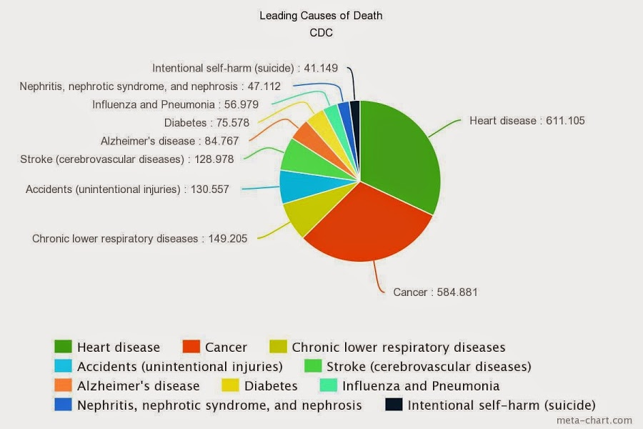
Background

Slide 5


Background
About 47% of sudden cardiac deaths occur outside a hospital. This suggests that many people with heart disease don’t respond fast [2].

Slide 6

Background
THE number of elderly people in the world's population is increasing signicantly. The number of people 60 years of age and over has been projected to reach approximately 700 million by 2009 and 2 billion by 2050 [3].

Slide 7
Background(CONT).
Internet of things on HealthCare
Remotes monitoring
Reduce the health care expense
Instant remedy and result
To have a knowledge owns health condition

Slide 8
Biosensor?
Background(CONT).
As many definitions as workers in the field!
I favor:
“a device that utilizes biological components e.g. enzymes to indicate the amount of a biomaterial”

Slide 9
Motivation
Background(CONT).
To minimize the response time.
Provide emergency medical assistance

Slide 10
Literature review
Ref | System | Technique Used | Advantages | Disadvantages
1 | WBAN for Heart Attack Detection | ST Evaluation | Low Cost, Low Energy. | No Remote Monitoring, No Cloud
2 | Continuous Change Detection in ECG | Markov-Model | Low Energy | No Remote Monitoring, No Cloud.
3 | Prediction System of Cardiac Arrest | ST Evaluation | Emergency Responses System. | No Remote Monitoring, No Cloud.
4 | Ambulant ECG Monitoring | Pan-Tompkins | Low Cost | No Remote Monitoring, No Cloud.

Slide 11
Problem Statements
No remote Monitoring for Heart Disease Patients.
Unavailability of complete portable real time ECG Monitoring system.
No system for Emergency Help.

Slide 12
Objectives
To introduce a system for real time monitoring heart disease patient’s remotly that can minimize the response time in emergency situation.
To develop a wireless body area network for monitoring heart rate of critical patient’s.

Slide 13
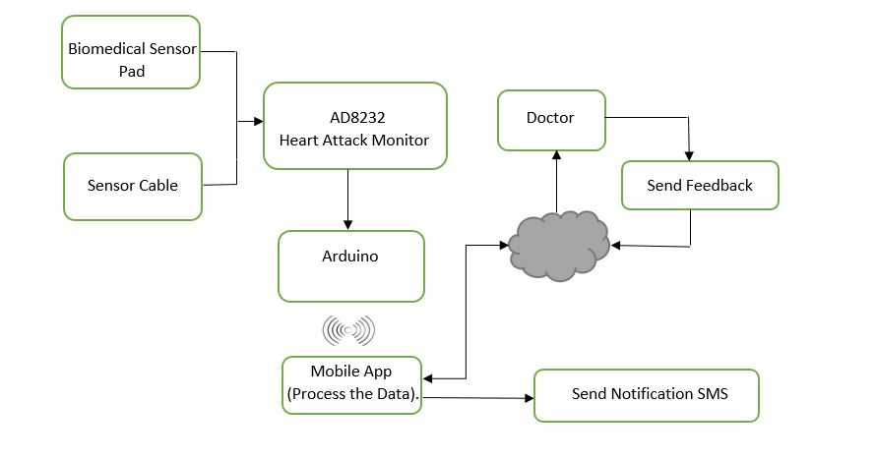
Design and Methodology
Block Diagram of Our Project

Slide 14
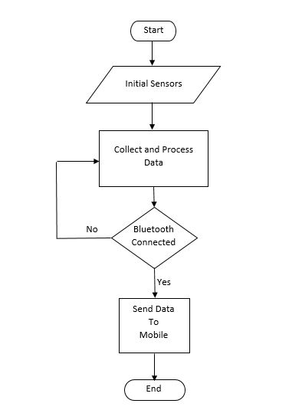
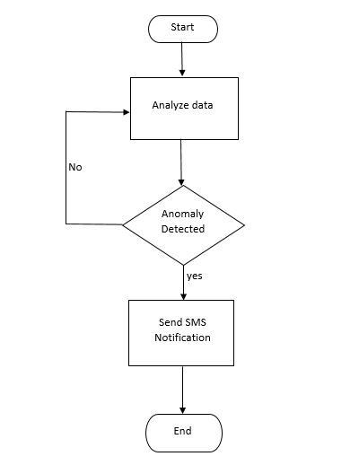
Design and Methodology(CONT).
Flow Chart for the complete design methodology

Slide 15
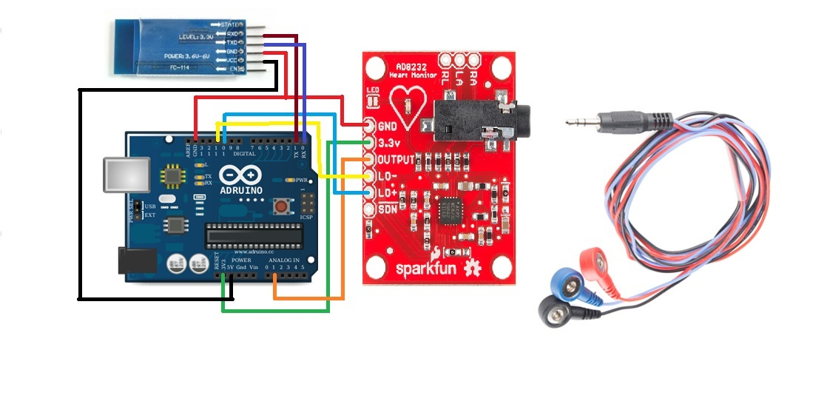
Design and Methodology(CONT).
Hardware Connection of Our Project

Slide 16
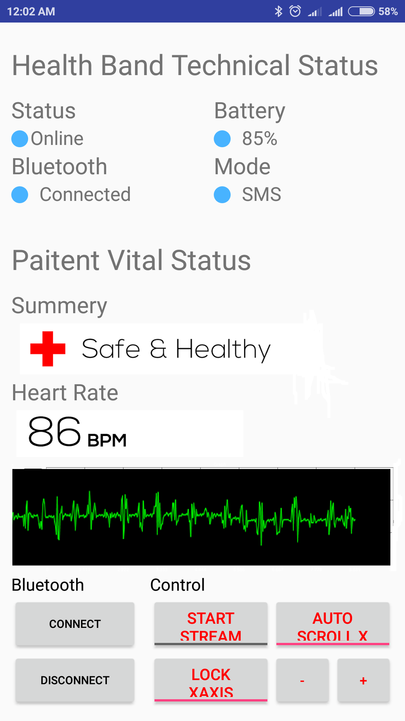
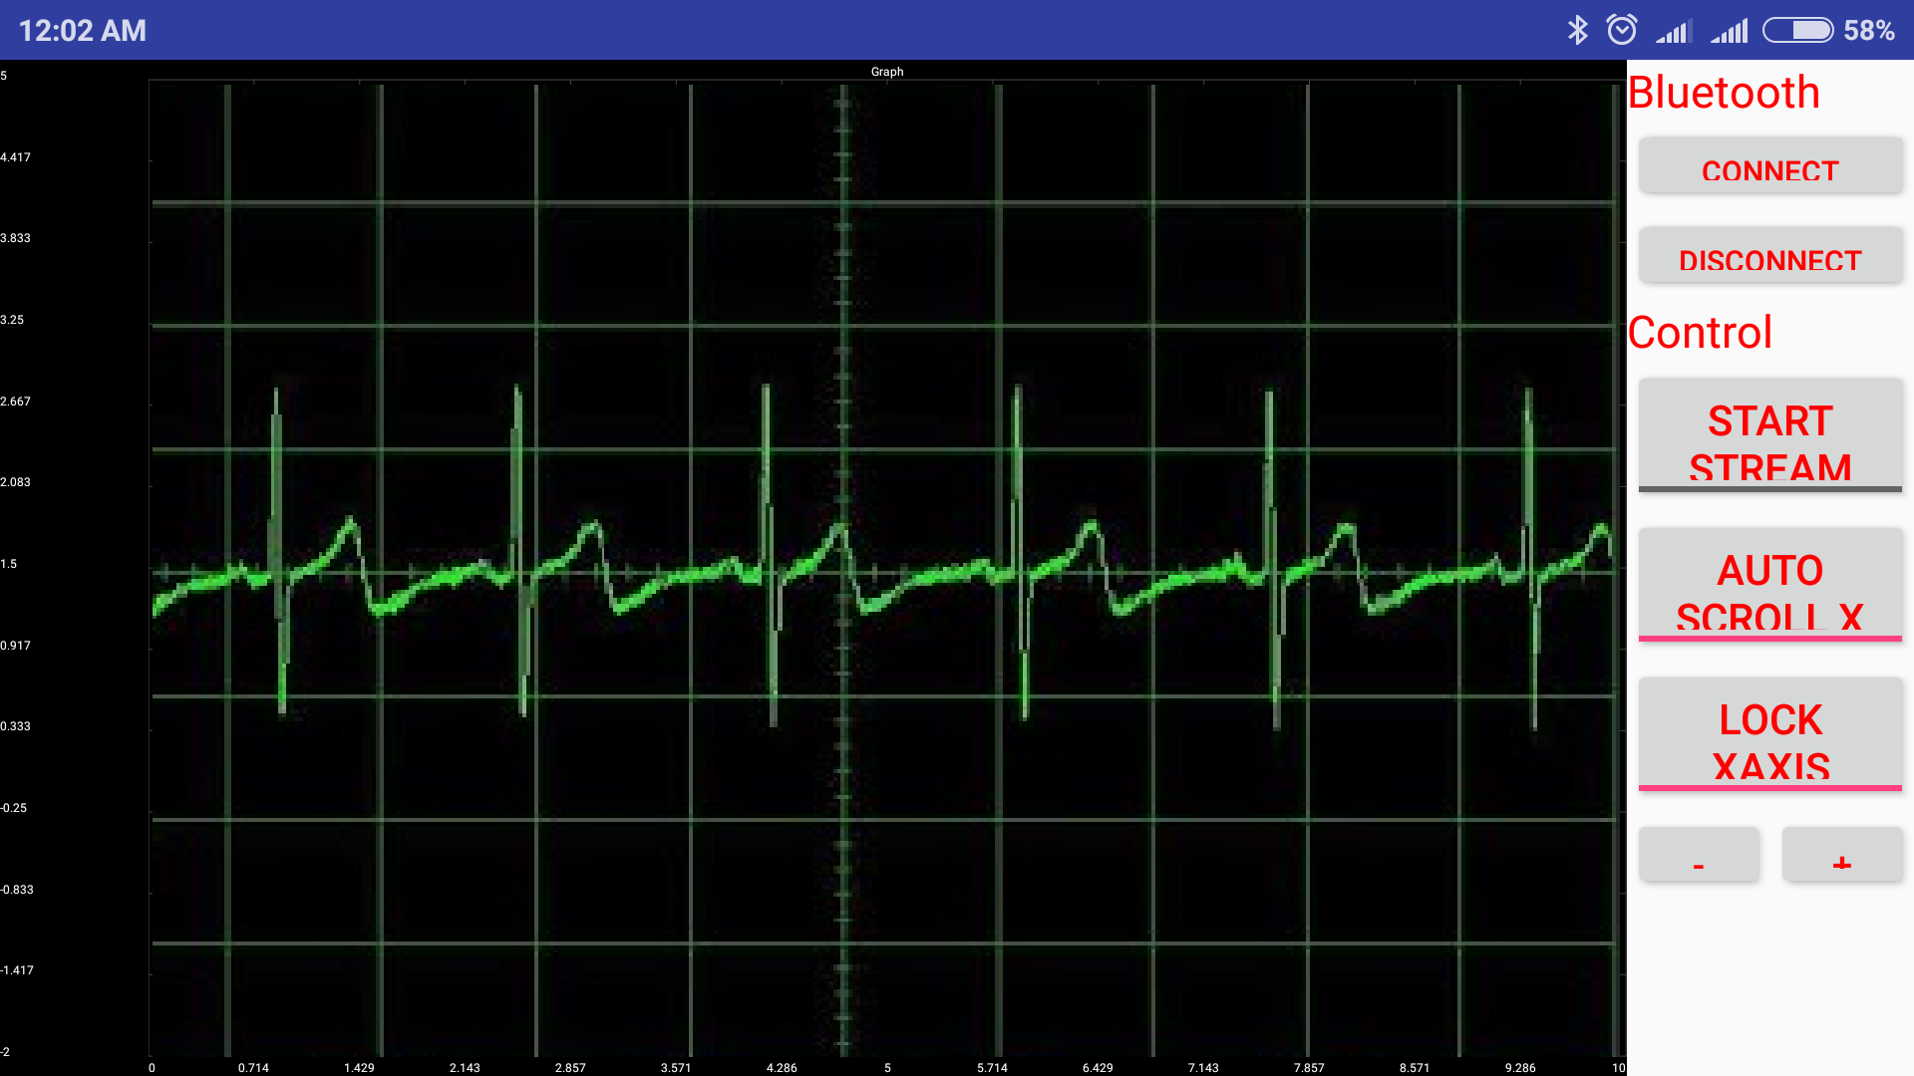
Results and Discussion

Slide 17
Results and Discussion
Patient ID | Actual Heart Rate | Detected Heart Rate | Accuracy (%)
1 | 86 | 79 | 91.86%
2 | 89 | 83 | 94.38%
3 | 66 | 62 | 93.93%
4 | 84 | 79 | 94.04%
5 | 75 | 72 | 96%

Slide 18
Conclusion
Developed a system for real time monitoring of heart disease patient that can generate alert in life threatening situations.

Slide 19
Future Work
Develop a system for doctor to suggest patient in case of life threatening situation of patient.
Maintain a cloud server to store the record patient’s information and Electrocardiography.
Use of BITalino (r)evolution Board Kit for more accurate Signal.

Slide 20
Potential Application
Medical Institutes can this kind of wearable device for remote monitoring.

Slide 21
References
[1] CDC, NCHS. Underlying Cause of Death 1999-2013 on CDC WONDER Online Database, released 2015. Data are from the Multiple Cause of Death Files, 1999-2013, as compiled from data provided by the 57 vital statistics jurisdictions through the Vital Statistics Cooperative Program. Accessed Feb. 3, 2015.
[2] CDC. State Specific Mortality from Sudden Cardiac Death: United States, 1999. MMWR. 2002;51(6):123–126.
[3] “World population prospects the 2008 revision: Volume I: Comprehensive tables,” United Nations, Dept. Econ. Soc. Affairs, Population Division, New York, NY, USA, Tech. Rep. ST/ESA/SER.A/287, 2009.
[4] Franca Delmastro, “Pervasive communications in healthcare”, Computer Communications Vol.35, pp.1284– 1295,2012. Aruna Devi.S et al. / International Journal of Computer Science & Engineering Technology (IJCSET) ISSN: 2229-3345 Vol. 7 No. 03 Mar 2016 72
[5] Jongyoon Choi, Beena Ahmed and Ricardo Gutierrez-Osuna, Development and valuation of an Ambulatory Stress Monitor Based on Wearable Sensors, IEEE transactions on information technology in biomedicine, vol. 16, no. 2, March 2012

Slide 22
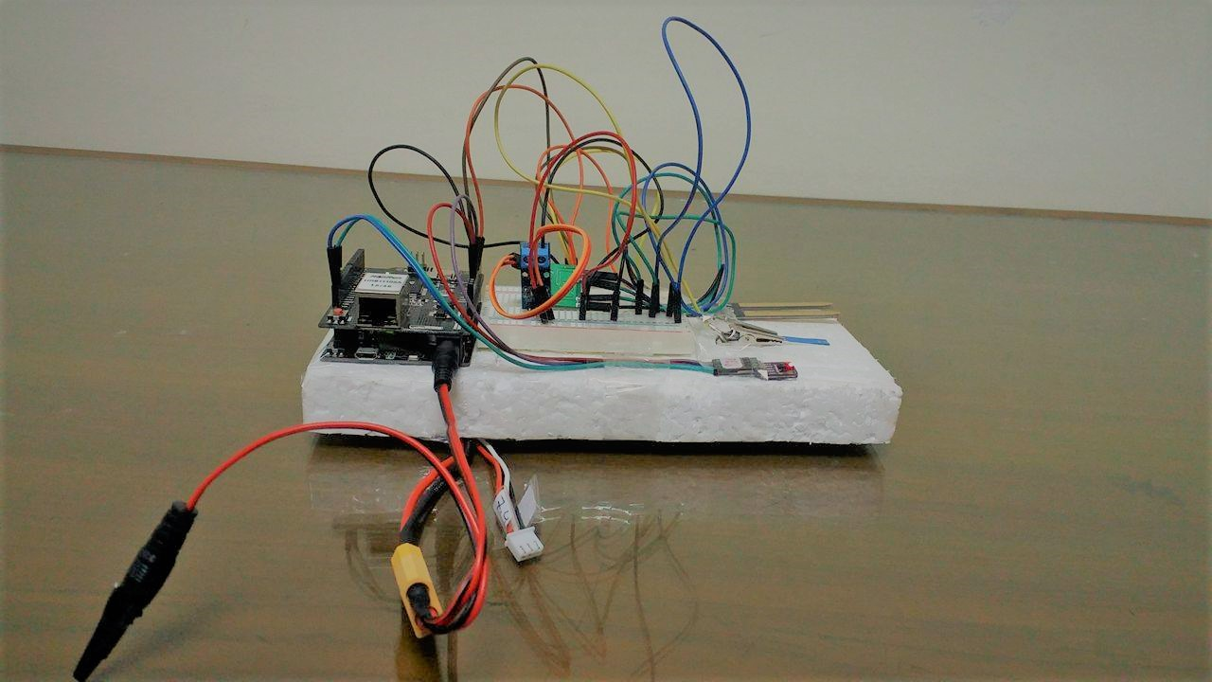
Demonstration

Slide 23
Thank You ☺

Slide 24
Any Question??

